Slide 1
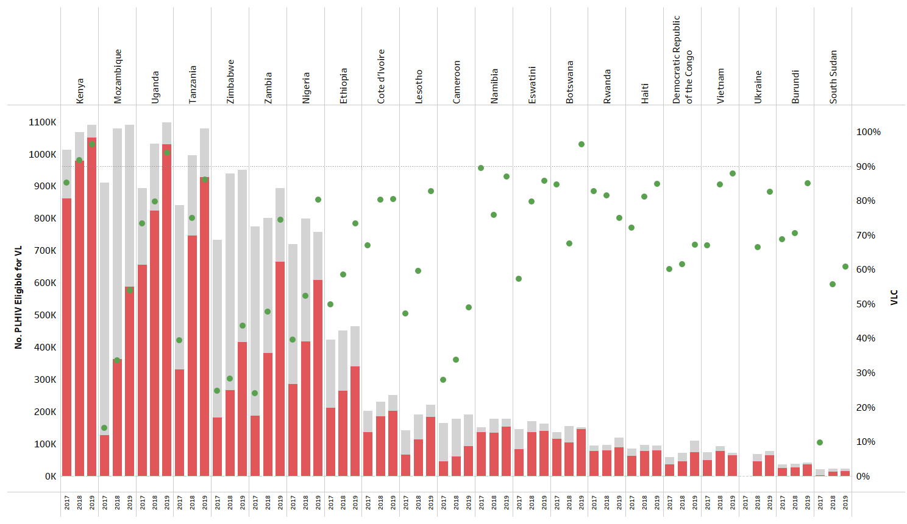
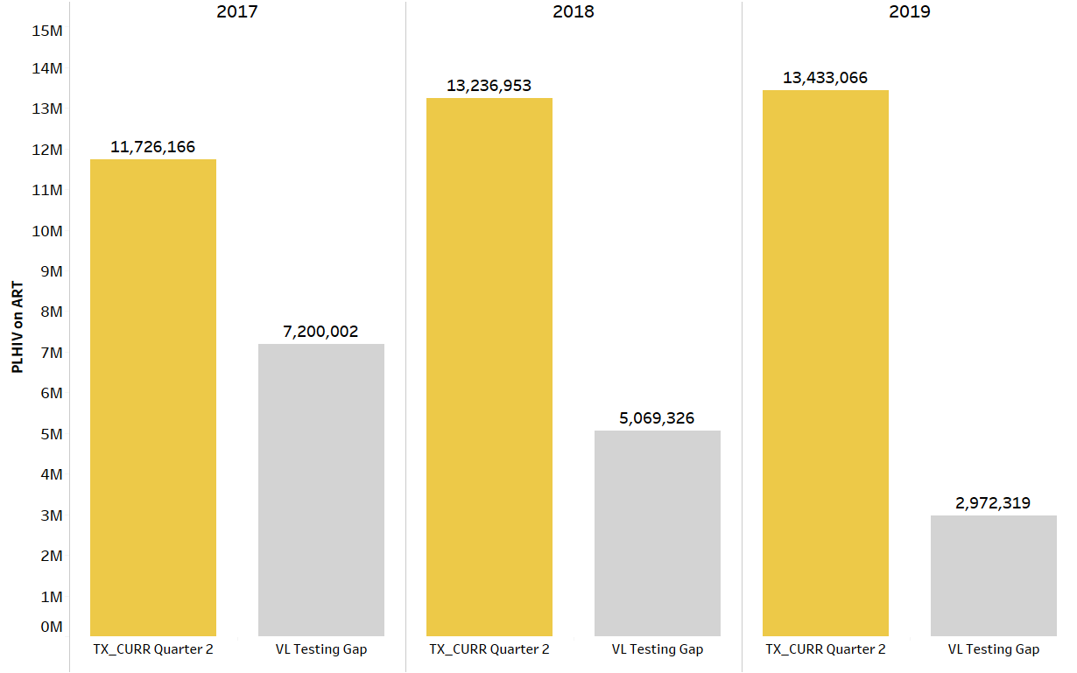
#PEB0113
Need for Improved Demand Creation and Accelerated Viral Load Testing Coverage to Meet UNAIDS HIV Treatment Targets
George Alemnji (OGAC), Yaa Obeng-Aduasare (OGAC), Catherine Godfrey (OGAC), Heather Watts (OGAC,)
Background: A suppressed HIV viral load (VL) indicates effective antiretroviral therapy (ART). Measuring the VL of all patients on ART and acting upon these results remains a challenge in many countries. Low testing demand, issues with sample transport, laboratory testing, and utilization of test results are all factors impacting the viral load testing coverage in PEPFAR countries.
Methods: PEPFAR collaborates with countries to improve demand for VL testing (Figure 1). A first viral load for PLHIV is assessed at six months after initiating ART.Site level VL testing coverage and gaps data from 21 countries between FY2017 and 2019 were compared using a nested Welch Two-Sample T-test to determine differences between eligible PLHIV receiving VL testing (testing coverage) and those who did not (testing gaps).
Results: There was significant improvement (P<0.05) between FY17 and FY19 in number of PLHIV with VL test documented in medical records in 17 countries (Figure 2). Four of the 21 countries (Burundi, Democratic Republic of Congo, Namibia, Vietnam) show no significant change over the years in number of PLHIV who received a VL test, though closer to 90% target.
Conclusions: There is need for more demand creation activities such as treatment literacy training and promoting awareness and education of VL testing and utilization of results for patient management to increase testing
Figure 2: Significant Decrease in Viral Load Testing Gaps between FY17 - 19
Figure 1: Global Trends in PEPFAR Viral Load Testing Gap, FY17 - 19

